Slide 1



Local Storage

Slide 2
1.
Local Storage & DataBase

Slide 3
What is Local Storage?
Local Storage means persisting data directly on the user’s device, so it survives app restarts & can be accessed offline.
This stored data is called Database.

Slide 4
Types of Databases

Slide 5
Relational Database
In Relational database, data is contained within a table.
Relationships between tables are formed when a primary key, which uniquely identifies a row in one table, connects with a foreign key, identifying a row of data in another table.
SQL, or structured query language, is the most common programming language to interface within relational database management systems.

Slide 6
Non-Relational Database
Unlike relation databases, which only support a tabular design, there are many different types of non-relational databases, that include:
Key-value stores

Slide 7
2.
Local storage options

Slide 8
Common solutions
SharedPrefrences: Simple Key-value for small, non-sensitive, non-relational data like flags or UI Settings.
Hive: key-value non-relational databases for structured or larger databases.
SQLite: for relational databases.

Slide 9
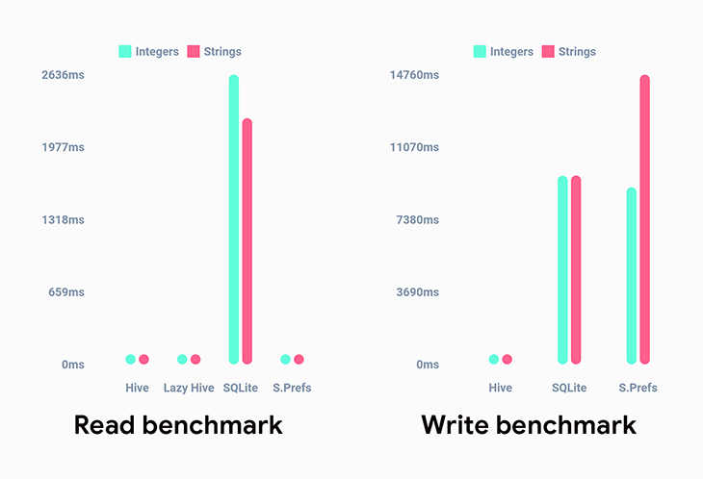
Why Hive?

Slide 10
3.
Hive

Slide 11
Boxes in Hive
Hive uses the concept of “boxes” for storing data.
A box is like a table in an SQL Database, except the boxes lack a strict structure.
This means boxes are flexible and can only handle simple relationships between data.

Slide 12
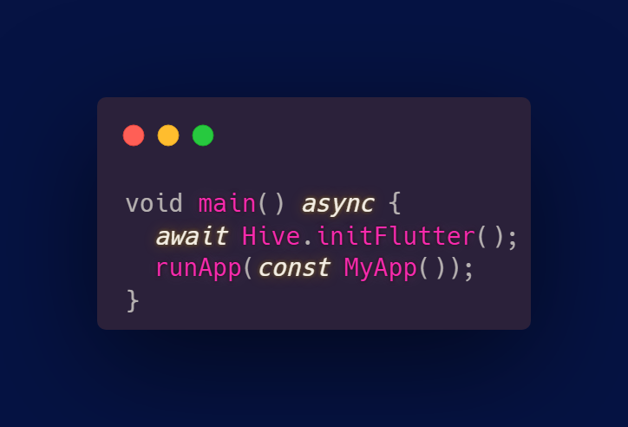
Initializing Hive

Slide 13
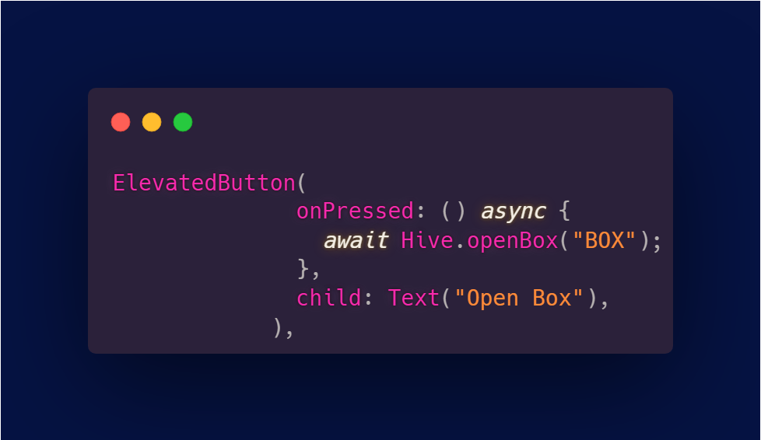
Opening Box

Slide 14
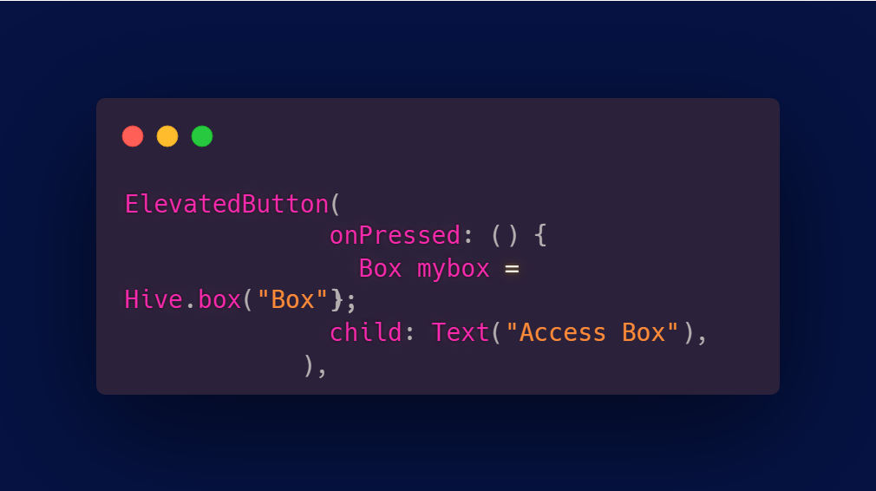
Accessing Box

Slide 15
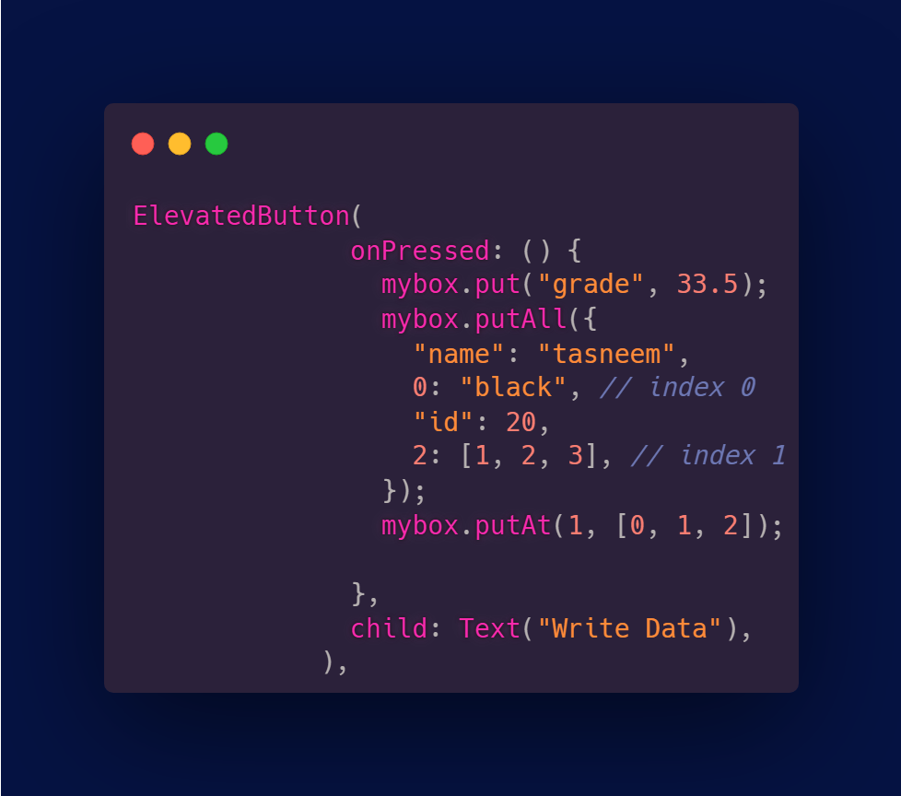
Storing Data (Put)

Slide 16
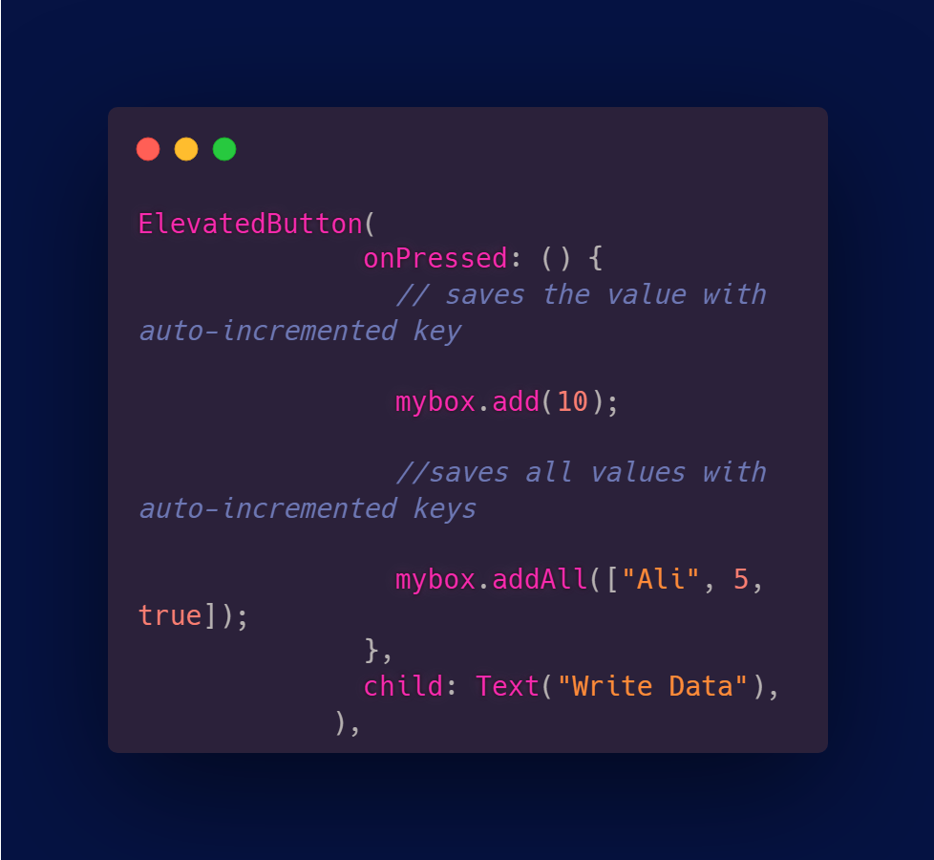
Storing Data (Add)

Slide 17
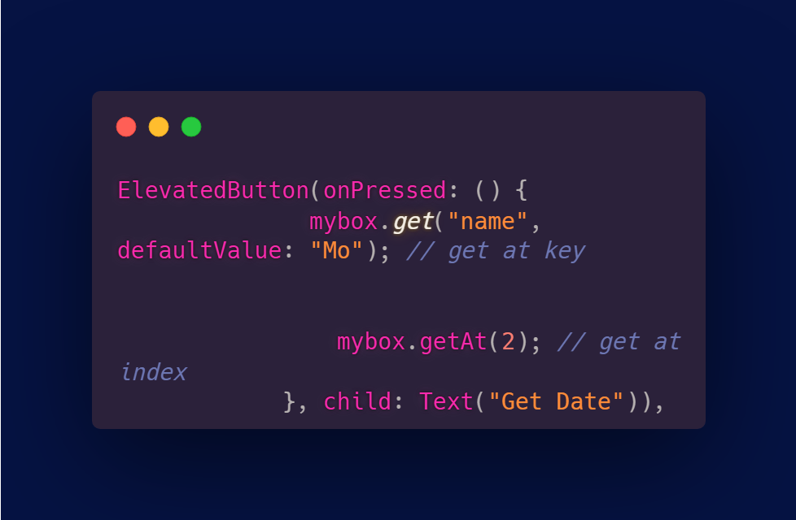
Retreieve Data (Get)

Slide 18
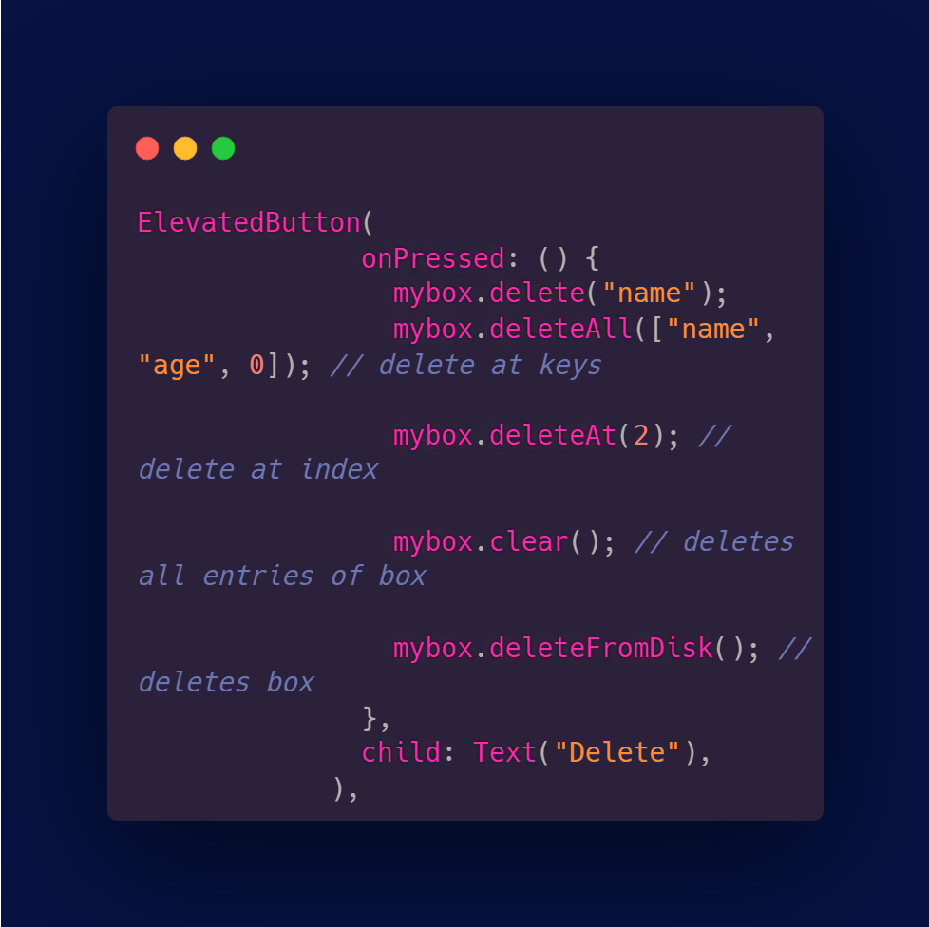
Delete Data

Slide 19
Using custom objects

Slide 20
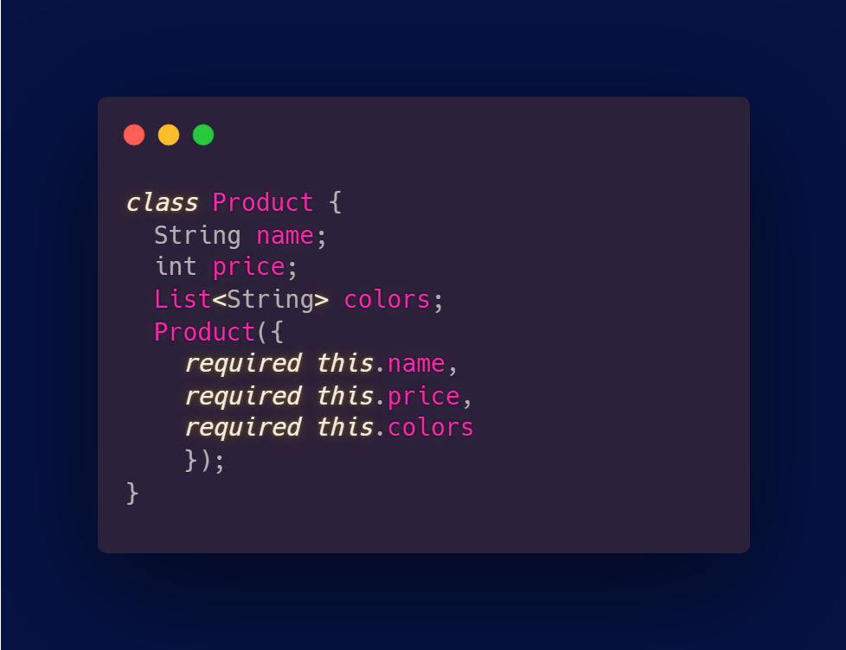
Custom Class

Slide 21
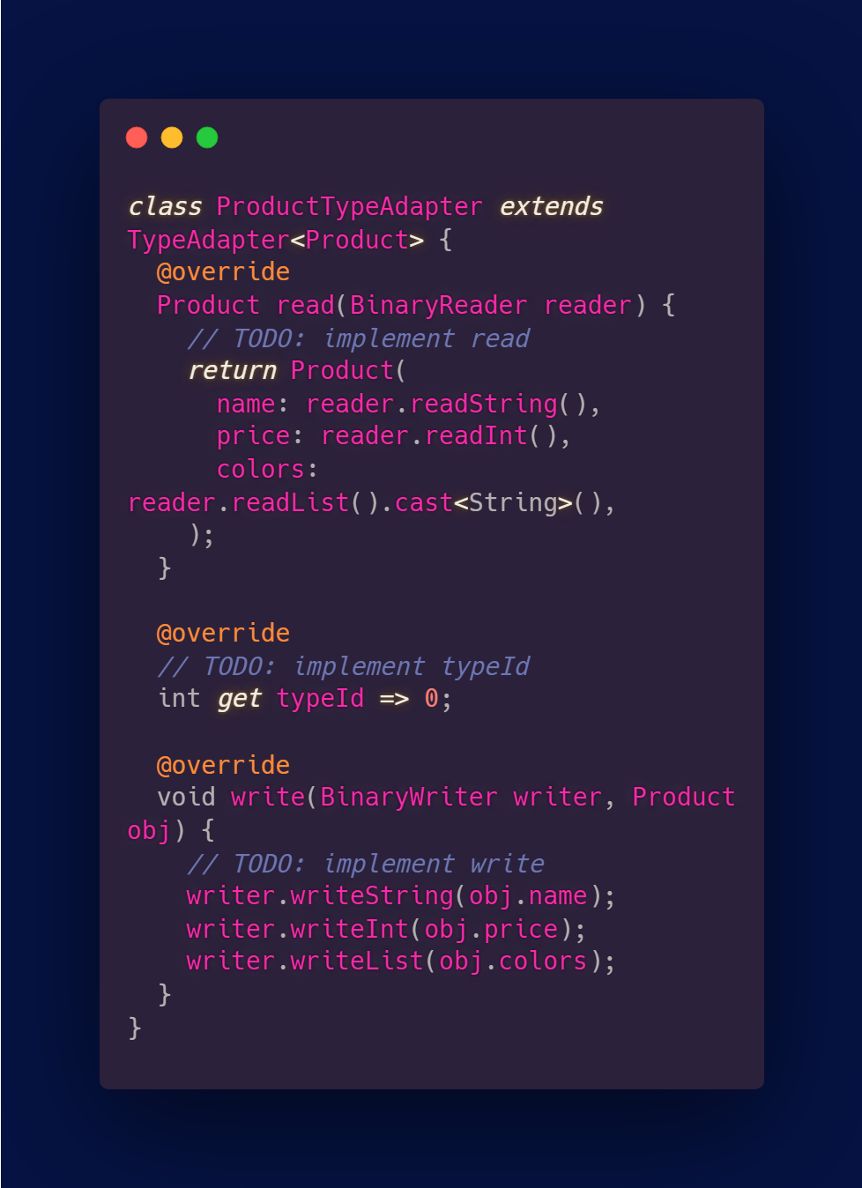
TypeAdapter

Slide 22
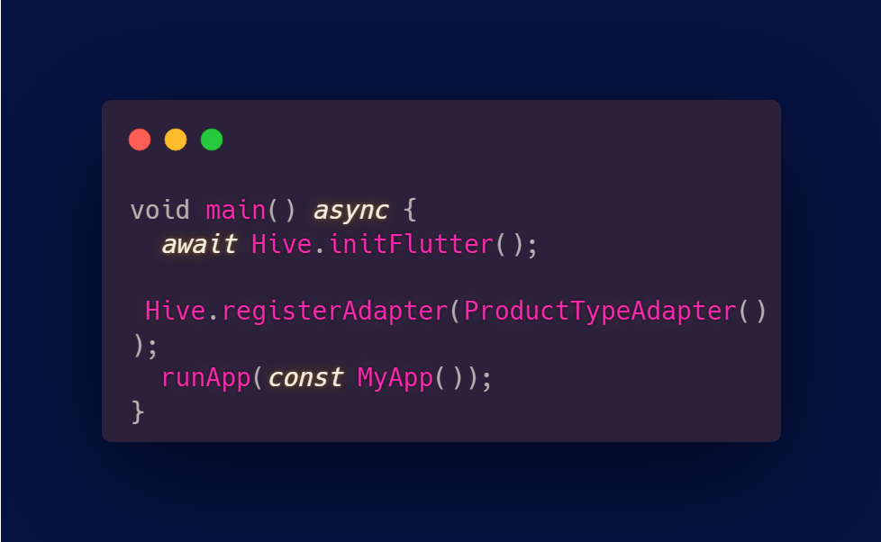
Register the TypeAdapter

Slide 23
Hands on

Slide 24
Thank you!

